Slide 1
Teacher Input Forms - Present Levels of Academic Achievement and Functional Performance (PLAAFP)
By
Julious “Jay” Morris
ARD Facilitator
Alvin ISD

Slide 2
What is a Teacher Input Form?
Lists the SPED Student Information (will be filled out by Case Manager)
Able to list missing assignments
List Academic Strengths
List Academic Weaknesses
Identify Behaviors
Identify Social Interactions
Compliance of Staff Directives
Use of Grade Level Materials

Slide 3
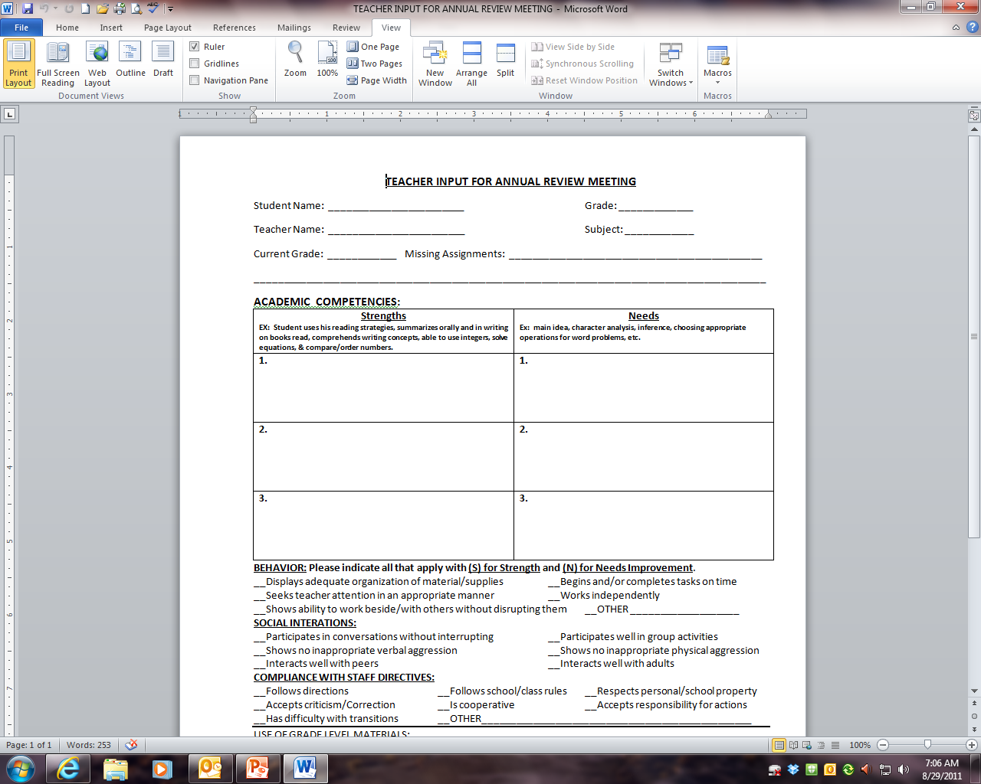
Teacher Input Form

Slide 4
Teacher Input Form
Case Manager will input the pertinent information.
Current Grade: Please put in their current grade from your grade book.
Please put in any missing assignments for the SPED Case Manager.

Slide 5
Teacher Input Form- Academic competencies
Strengths & Weaknesses
Good Examples:
Student is able to use his reading strategies
Can read and comprehend grade level material
Able to use integers
Able to solve simple/complex algebraic problems
Understands the composition of the earths layers
Understands the significance of the Revolutionary War

Slide 6
Teacher Input Form- Academic competencies
Strengths & Weaknesses
More Good Examples (you can just list TEKS):
Word Identification 8.6B – Structural Analysis – Affixes
Summary 8.10G
A.1D Solving Equations by Adding and Subtracting
Science Example TEK
8.3(B) use models to represent aspects of the natural world such as an atom, a molecule, space, or a geologic feature;
Social Studies/History Example:
TEKS: 1a-c, 2a-b, 3a-c
SPED Case Manager will be able pull up the TEKS to copy and paste, it just takes longer to prepare the PLAAFP for the ARD.

Slide 7
Teacher Input Form- Academic competencies
Strengths & Weaknesses
What should NOT be listed:
Has trouble focusing on material
Does not complete homework
Can participate in group activities in class
Can stay awake during instruction
These are types of behaviors and will be addressed at the bottom of the Teacher Input Form.

Slide 8
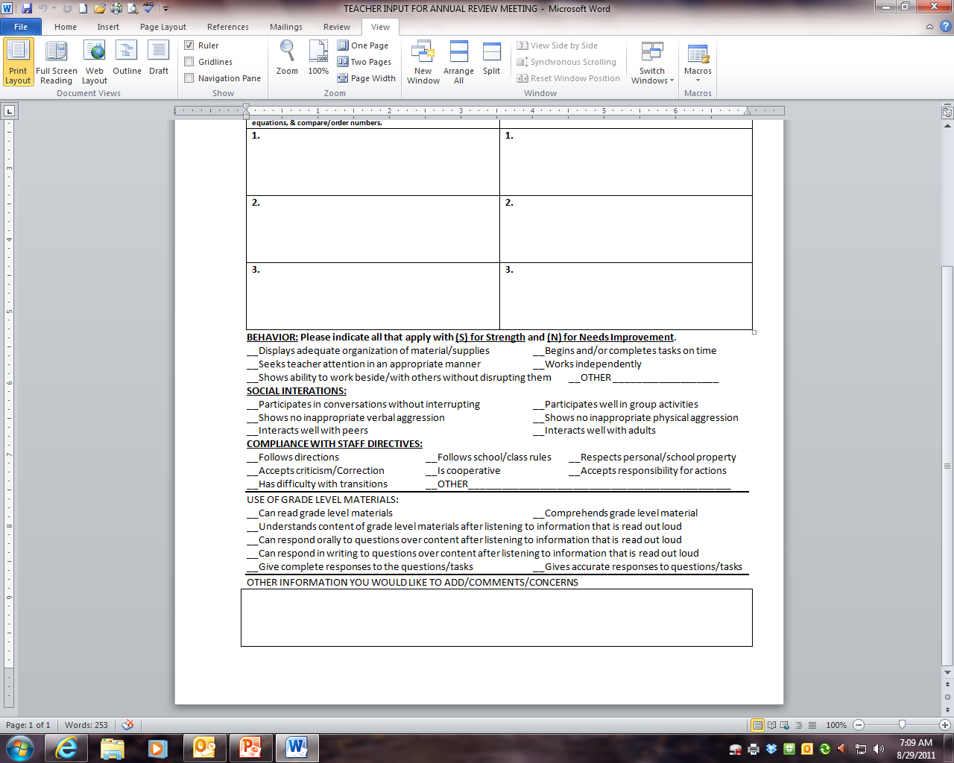
Teacher Input Form

Slide 9
Teacher Input Form – Continued…
Behaviors, Social Interactions, Compliance with Staff Directives
Read each statement and place an (S) for Strength and an (N) for Needs Improvement.
Other Information you would like to Add/Comments/Concerns
This box, you can list anything else you feel is important that needs to be discussed at the ARD meeting.

Slide 10
Questions & Comments?
The ARD Meetings will be scheduled at least 2 to 3 weeks prior to the Annual Due Date.
Your SPED Case manager will be sending the Teacher Input Form via E-mail attachment.
You can fill the form out on the computer and return it to the Case Manager.
You can print and fill in by hand and return to the Case Manger.
Your input will help the Case Manager develop appropriate IEP Goals and Objectives for the particular student.
Please return the form as soon as you can to the Case Manager so that they will have time to prepare for the ARD Meeting.
Thank you for your Time and Patience when working with our Special Needs Population. Remember, our ultimate goal of Special Education is to work with struggling students to get them close or on grade level, ultimately being dismissed as a special needs student.

Slide 11
Have a Great Year!

